Slide 1
Performance Gain related to MSRP
Chris Le, Robert Bonham, Carson Holland

Slide 2
Goals/Overview
The primary objective of this project is to assess performance gains year-to-year based off MSRP
Intel – ARM switch

Slide 3

Mac Specs
Year | Architecture | Processor | CPU Cores | RAM (GB) | MSRP ($)
2019 | X86 | 8th Gen Intel I5 | 4 | 8 | 1,299
2020 | ARM | M1 | 8 | 8 | 1,299
2021 | ARM | M1 Pro | 10 | 16 | 2,499

Slide 4
Performance Benchmarks
Scale.c, Quicksort.cpp, Ranksort.c
Constant data count – increased threads
(Measures parallelism in multi-thread performance)
Constant one thread– increased data count
(Measures the power/speed of one thread) Thread efficiency

Slide 5
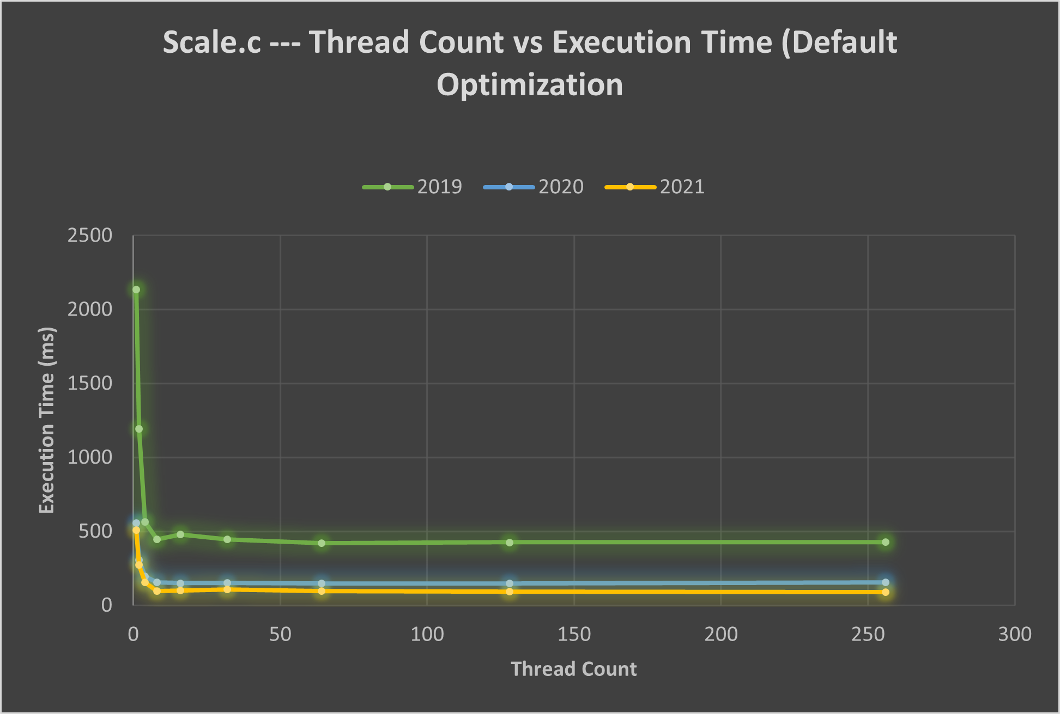
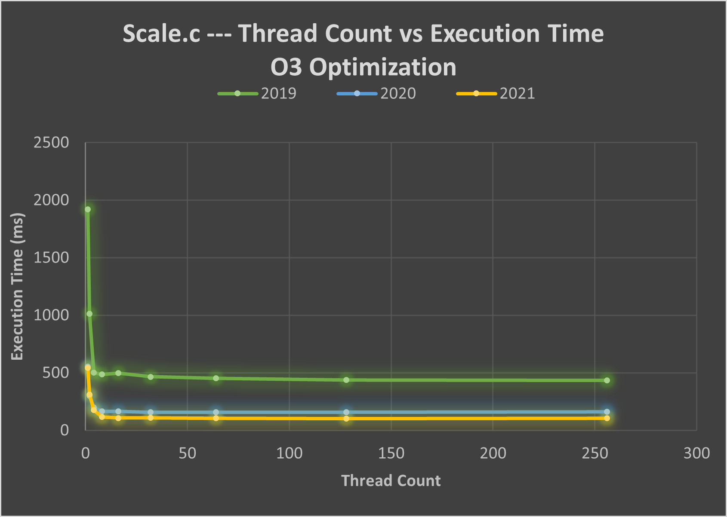
Scale.c Data Thread Count Testing

Slide 6
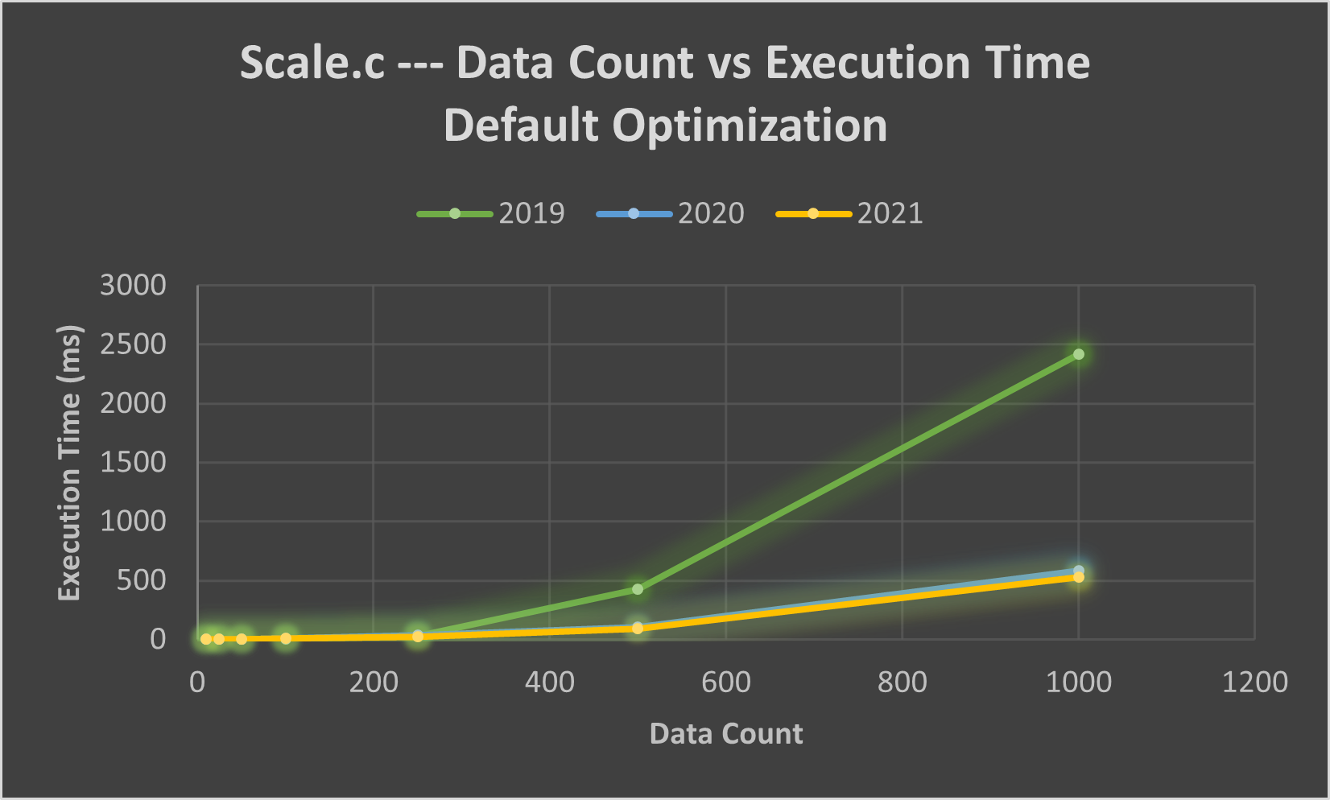
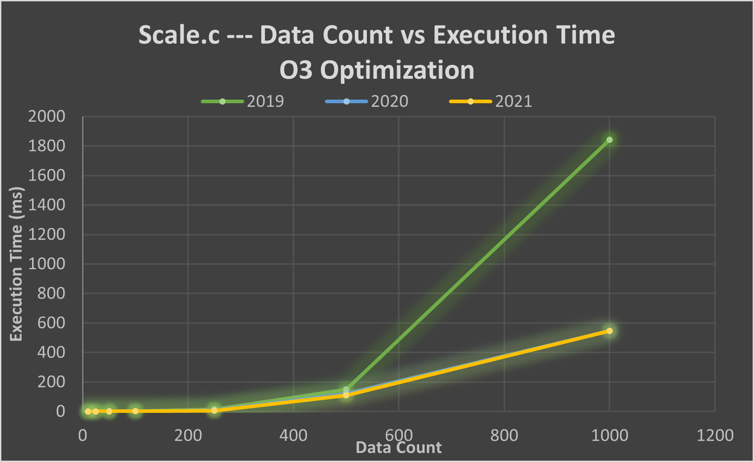
Scale.c Data Count Testing

Slide 7
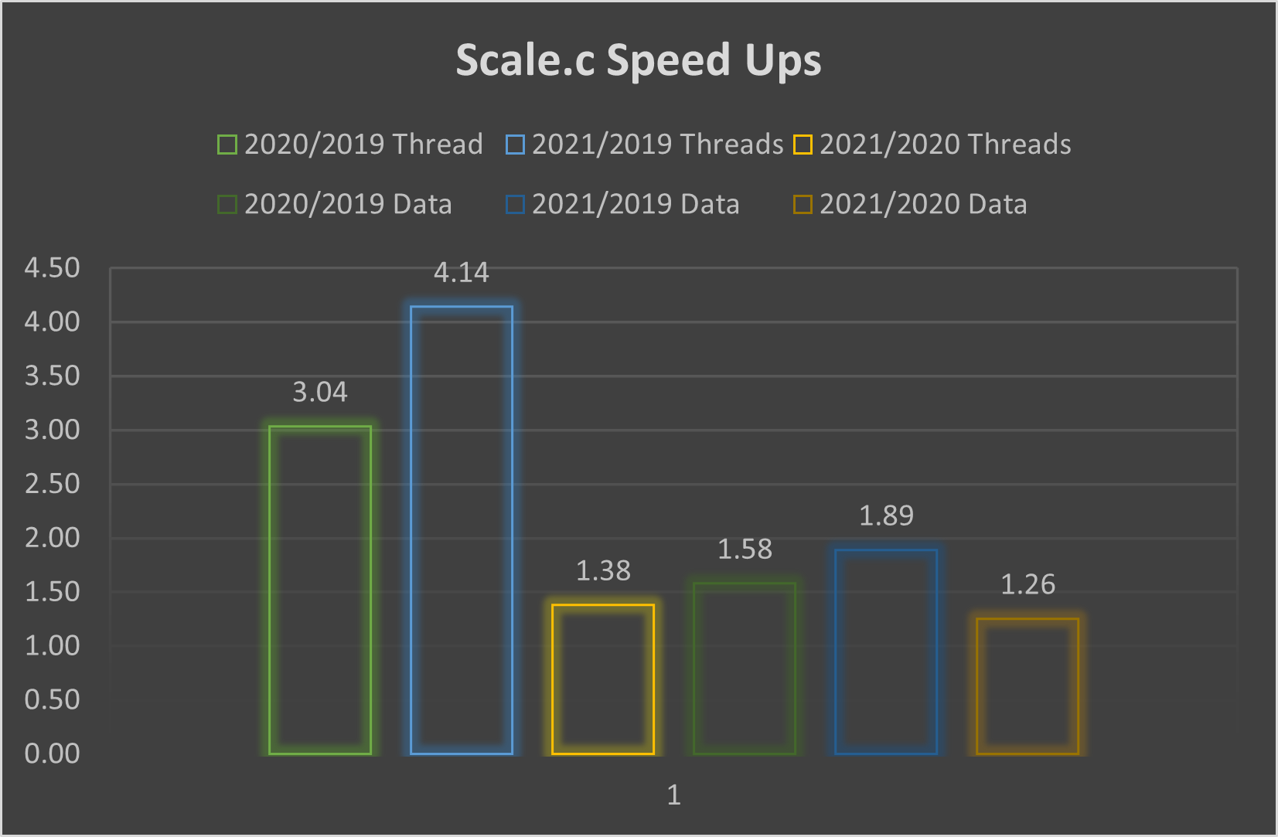
Scale.c Speed Up Ratios

Slide 8
Minecraft Testing
A general, common day to day use case.
Render distance, fast graphics, identical seeds, identical coordinates
Measure CPU temperature and percentages, FPS
Minimal background applications.

